Slide 1
Geolocations Of Microblog Users
Semantic Web Mining , Group 3

Slide 2
Overview
Extraction of Tweets
Processing of Tweets viz classification, noise filtering , bot removal
Visualizing the result
Validating the results

Slide 3
Extraction of Tweets
Using Twitter API and Python Module tweepy extracted tweets corresponding to the User Ids
Also extracted the friends and followers of a particular users and their locations

Slide 4
Fuzzy Matching Algorithm
Dictionary generation using the enchant library in Python.
Using enchant library to predict possible words for a string whose lookup in the dictionary fails
A ranking mechanisms replaces the incorrect string with the highest ranked values in the set determined by the fuzzy wuzzy library

Slide 5
Fuzzy Matching Algorithm
Complications
It replaces proper nouns too like names of people/cities etc.
We overcome this problem by determining nouns in the speech and ignoring it by using part-of-speech tagger.

Slide 6
Processing of Tweets
Removed the stop words and unwanted characters from the tweets
Applied fuzzy logic to get the best possible meanings of the words
Removed the bot accounts including the bot friends and followers

Slide 7
Bot Filtering
Based on User Behavior Heuristics
Users With Few Followers(twitter.user.follower_ratio >= 0.01)
Bot-Friendly Content Sources(Ex: Twitterbot.net)
Compute BotProbability Score based on User’s recent 50 tweets.
Large number of HashTags, Http Links
Content asking for retweets and followers
If Bot Probability Score > Threshold, Filter out the user.

Slide 8
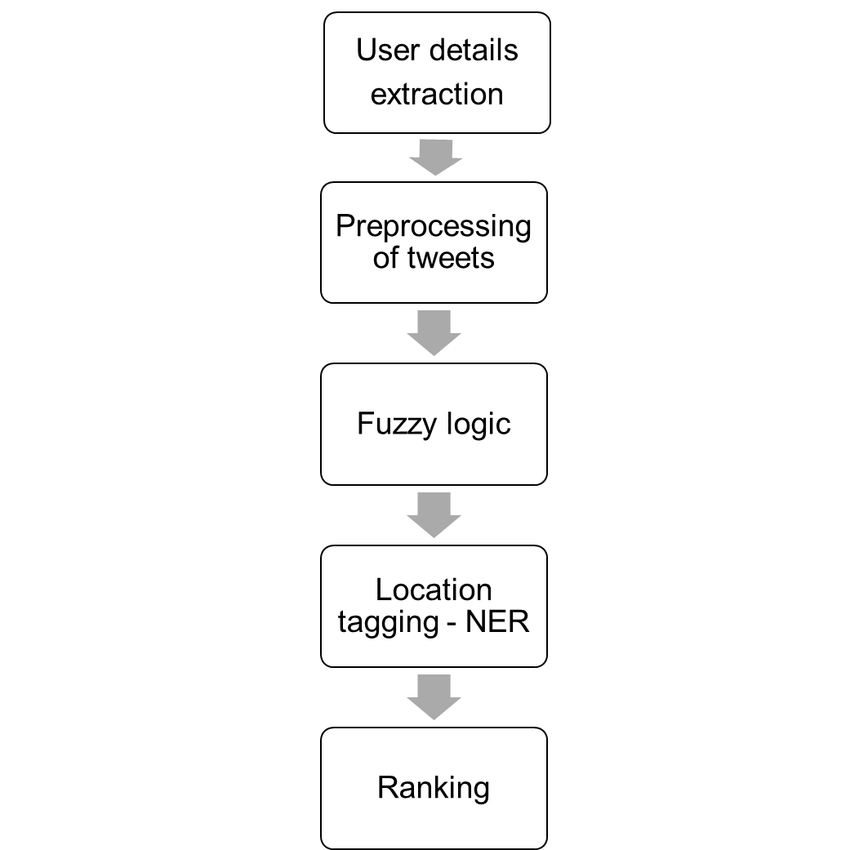
The Algorithm Explained

Slide 9
Classifications of tweets
Classified the cleaned tweets according the different locations at state level mentioned in the tweets

Slide 10
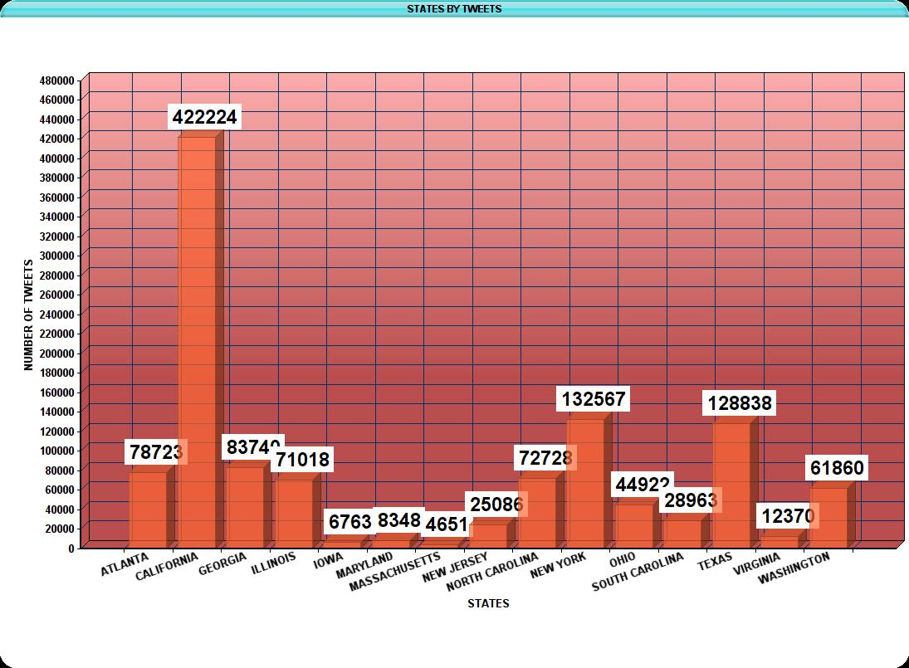
Number Of Tweets by State

Slide 11
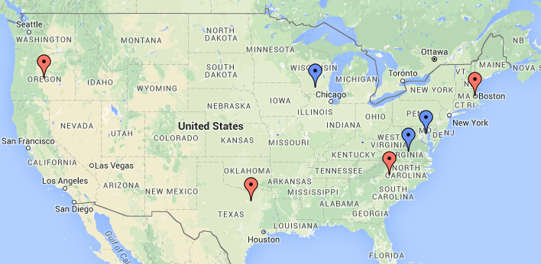
Computed and Actual locations

